Slide 1
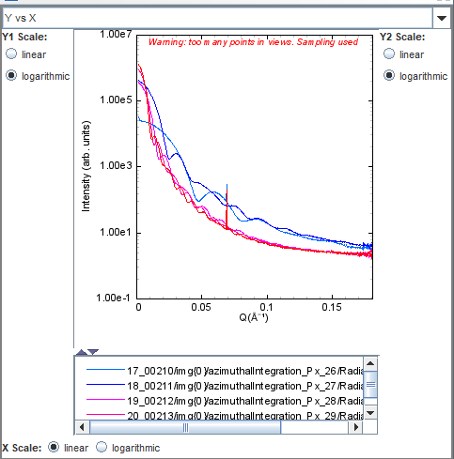
CGCH-158-DHs
The synthesis of DHs involve pentatwinned seeds. As the solution of PT seeds is not 100% PT, we produce BPs and other shapes. These shapes are too close to DHs so they cannot be separated by depletion.
R = 40
R = 300
R = 1000
R = 2500
R = 5000

